Slide 1
Public & Private Telling
Creating a safe space for story sharing

Slide 2
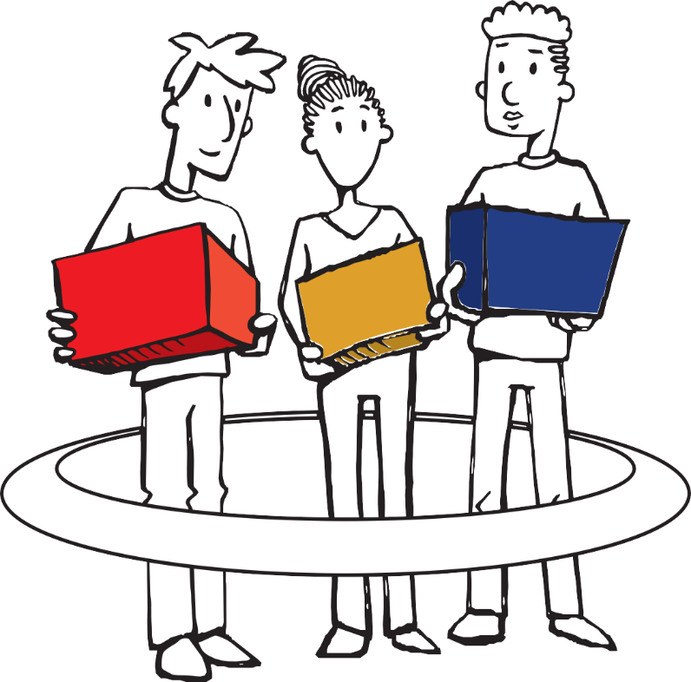
Sharing stories is a deeply personal process
UNDERSTANDING
RESPECT
TRUST
Safe Space
Notes:
Sharing our stories is a deeply personal thing. Ideally, we should feel empowered, connected and affirmed after sharing our stories, not misunderstood or hurt.
In order for that to happen, a safe space needs to be created. Three values are crucial in creating a safe space for sharing our stories:

Slide 3
Values for creating a safe space!
Being sympathetic & aware of other people’s feelings; tolerant and forgiving; compassionate.
TRUST
A confidence in someone or something that they are reliable and you feel safe with them.
RESPECT
Having regard or concern for the feelings, wishes, or rights of others.

Slide 4
Public and Private Telling
How much do I share?

Slide 5
Private telling!
Public telling!
A story for me!
For the world to see!
Notes:
Emotional regulation is linked to the idea of Private and Public Telling. Public telling are the things that you are happy to share with others. Private telling are stories, you write or draw, that are for yourself only, to help you think/ understand yourself better.

Slide 6
Private Telling
Public Telling
Is stories that you are happy to share with others.
Is stories you write or draw that are for yourself only, to help you think and understand yourself better.

