Slide 1
FRAME
Culture, Values & Understanding Unconscious Bias

Slide 2
Culture
Culture is the glue that holds our societies together.
But remember that culture is not fixed.
Culture is never a weapon to promote behaviour that is:
Unsafe
Unhealthy
Avoid saying things like:
‘All women like …’
All Zulu men want …’
‘All white people think…’

Slide 3
Values
We all have ideas about what is right and wrong and important in life.
These are our values
Our values are shaped by our:
religion
culture
family
experiences

Slide 4
Don’t
Force your values onto others.
Try to help someone see other points of view, especially if their own behaviour could harm them or others.
DO
Notes:
.

Slide 5
It is important to be aware of our culture and values so that we can avoid
BIAS

Slide 6
Bias
Bias is any opinion that influences a person’s thoughts, feelings or actions. Our biases are often shaped by factors like our upbringing, nationality, culture, values and beliefs.

Slide 7
If someone is biased against women, they might show that bias by hiring a man over a more qualified woman.
If someone is biased against a certain religion, they might show it by making rude or insensitive comments about that religion or its followers.

Slide 8
Bias is the foundation of
Stereotyping
Prejudice
Discrimination

Slide 9
Stereotype
A widely held fixed belief or image of a particular type of person or thing. It is
an over-generalised belief about a
category or group of people.
Notes:
Bias is rooted in Stereotype

Slide 10
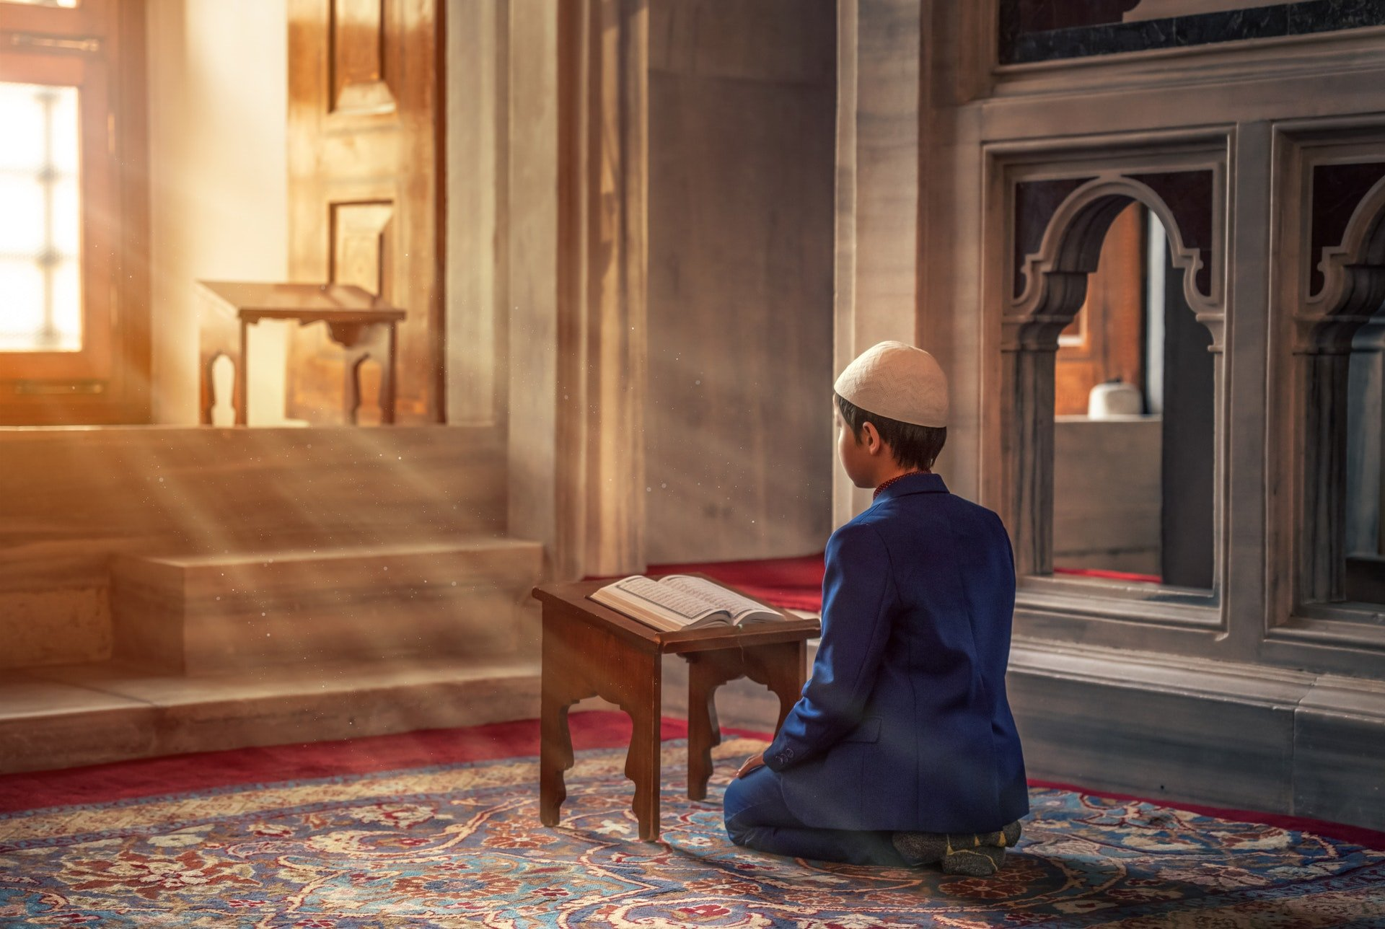
Prejudice
PREJUDICE is having a negative prejudgment or attitude about a group or its individual members.

Slide 11
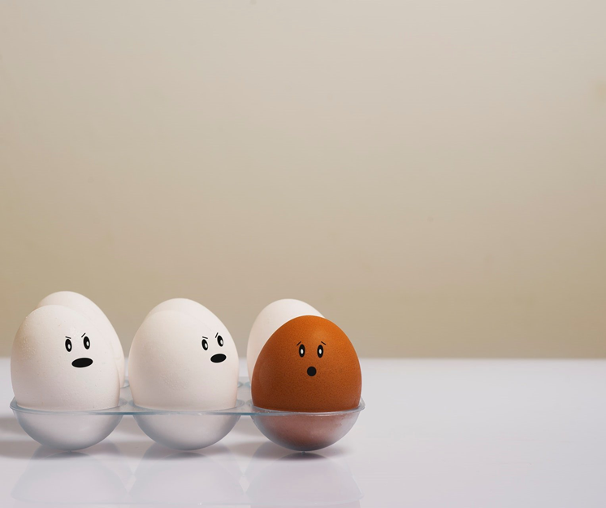
Discrimination
Behaviour that treats people unequally because of their culture, values, beliefs or race. This behaviour is unfair.

Slide 12
Unconscious bias
is prejudiced or unsupported judgments in favour of or against one thing, person, or group over another in a way that is unfair. These biases are learned. They are deeply ingrained in our beliefs and values.

Slide 13
What forms unconscious bias?
Our Frame
Our Frame is everything that makes up who we are and how we view the world.

Slide 14
Our FRAME is created by:
History/ancestral heritage
Neighbourhood we grew up in
Family
Neighbourhood we live in now
Religion
Physical abilities
Age
Values
Gender
Language
Education
Sexual orientation
Profession
Ethnicity
Culture/cultural traditions
Economic class

Slide 15
What can I do to challenge my own bias?
Become conscious of how our Frame:
shapes the judgments we make about other people.
shapes the way we view the world.

Slide 16
How do we do this?
Well, the word FRAME can also help us here as a tool to do just that.

Slide 17
Frame also stands for
Figure out the facts
Reflect on reality
Acknowledge and challenge assumptions
Maintain an open mind
Expand your experiences
Notes:
Figure out the facts. Not just what is apparent to you, but all the facts. Seek more information, ask questions and listen.
R — Reflect on reality. Is it my reality or their reality? Am I looking at this through my FRAME or trying to see
it through their FRAME?
A — Acknowledge and challenge assumptions. Think about your expectations and whether they are appropriate.
Are you making assumptions based on your FRAME?
M — Maintain an open mind. Just because someone else’s FRAME differs from yours doesn’t make them wrong.
What can you learn from them? What can they learn from you? What do you have in common?
E — Expand your experiences. Explore, expose yourself, and encounter differences; expand your comfort zone;
increase your cultural competenc

