Slide 1
Emotional Awareness
Understanding our emotions

Slide 2
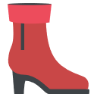
‘Before you put yourself in someone else’s shoes, you might first take a good look at your own
footwear!’
Kira Newman

Slide 3
Self-awareness: A definition
The ability to focus on yourself, and understand how your actions, thoughts, or emotions are in tune with your inner values and beliefs.
The ability to monitor your OWN emotions and thoughts from moment to moment is key to understanding yourself better.

Slide 4
Integral to self-awareness is emotional awareness!
This means being aware of your emotions and
how they affect you and those around you.
Being aware of your OWN thoughts and feelings will help you identify emotional signals in others. It will improve your ability to empathise with other people.

Slide 5
Research by the Yale Center for Emotional Intelligence shows that emotions influence our:
Attention
Memory and learning
Decision-making
Health
Creativity
Ability to form and maintain healthy relationships

Slide 6
Emotions can help or hinder us
Our emotions can hinder us when we let anger or despair overtake us.
Sometimes we are hijacked by intense emotions, especially unpleasant ones, such as:
anger
despair
Emotions can help us feel safe and content.
All emotions have a part to play in who we are.
etc.

Slide 7
So to prevent a single strong emotion from taking over we must learn to:
Recognise
Identify and label the feeling:
Regulate
Find strategies to express emotions in a way that is:
What am I feeling?
What made me feel this way?
Authentic
Appropriate
&

Slide 8
The Yale Center for Emotional Intelligence has developed two tools to help you become aware of and regulate your emotions:
Mood Index
The RULER Approach
The Mood Index used in WYS is adapted from the Center for Emotional Intelligence’s Mood Meter.

Slide 9
Recognise: Mood Index
Naming it can tame it.
It provides us with a ‘language’ to talk about our feelings.
The amount of effort the emotion
involves.
High energy
Low pleasure
High energy
High pleasure
Can you write three
examples of an
emotion that fits
in each
colour in the mood index?
Low energy
Low enjoyment
Low energy
High enjoyment
Enjoyment: How good does the emotion feel?

Slide 10
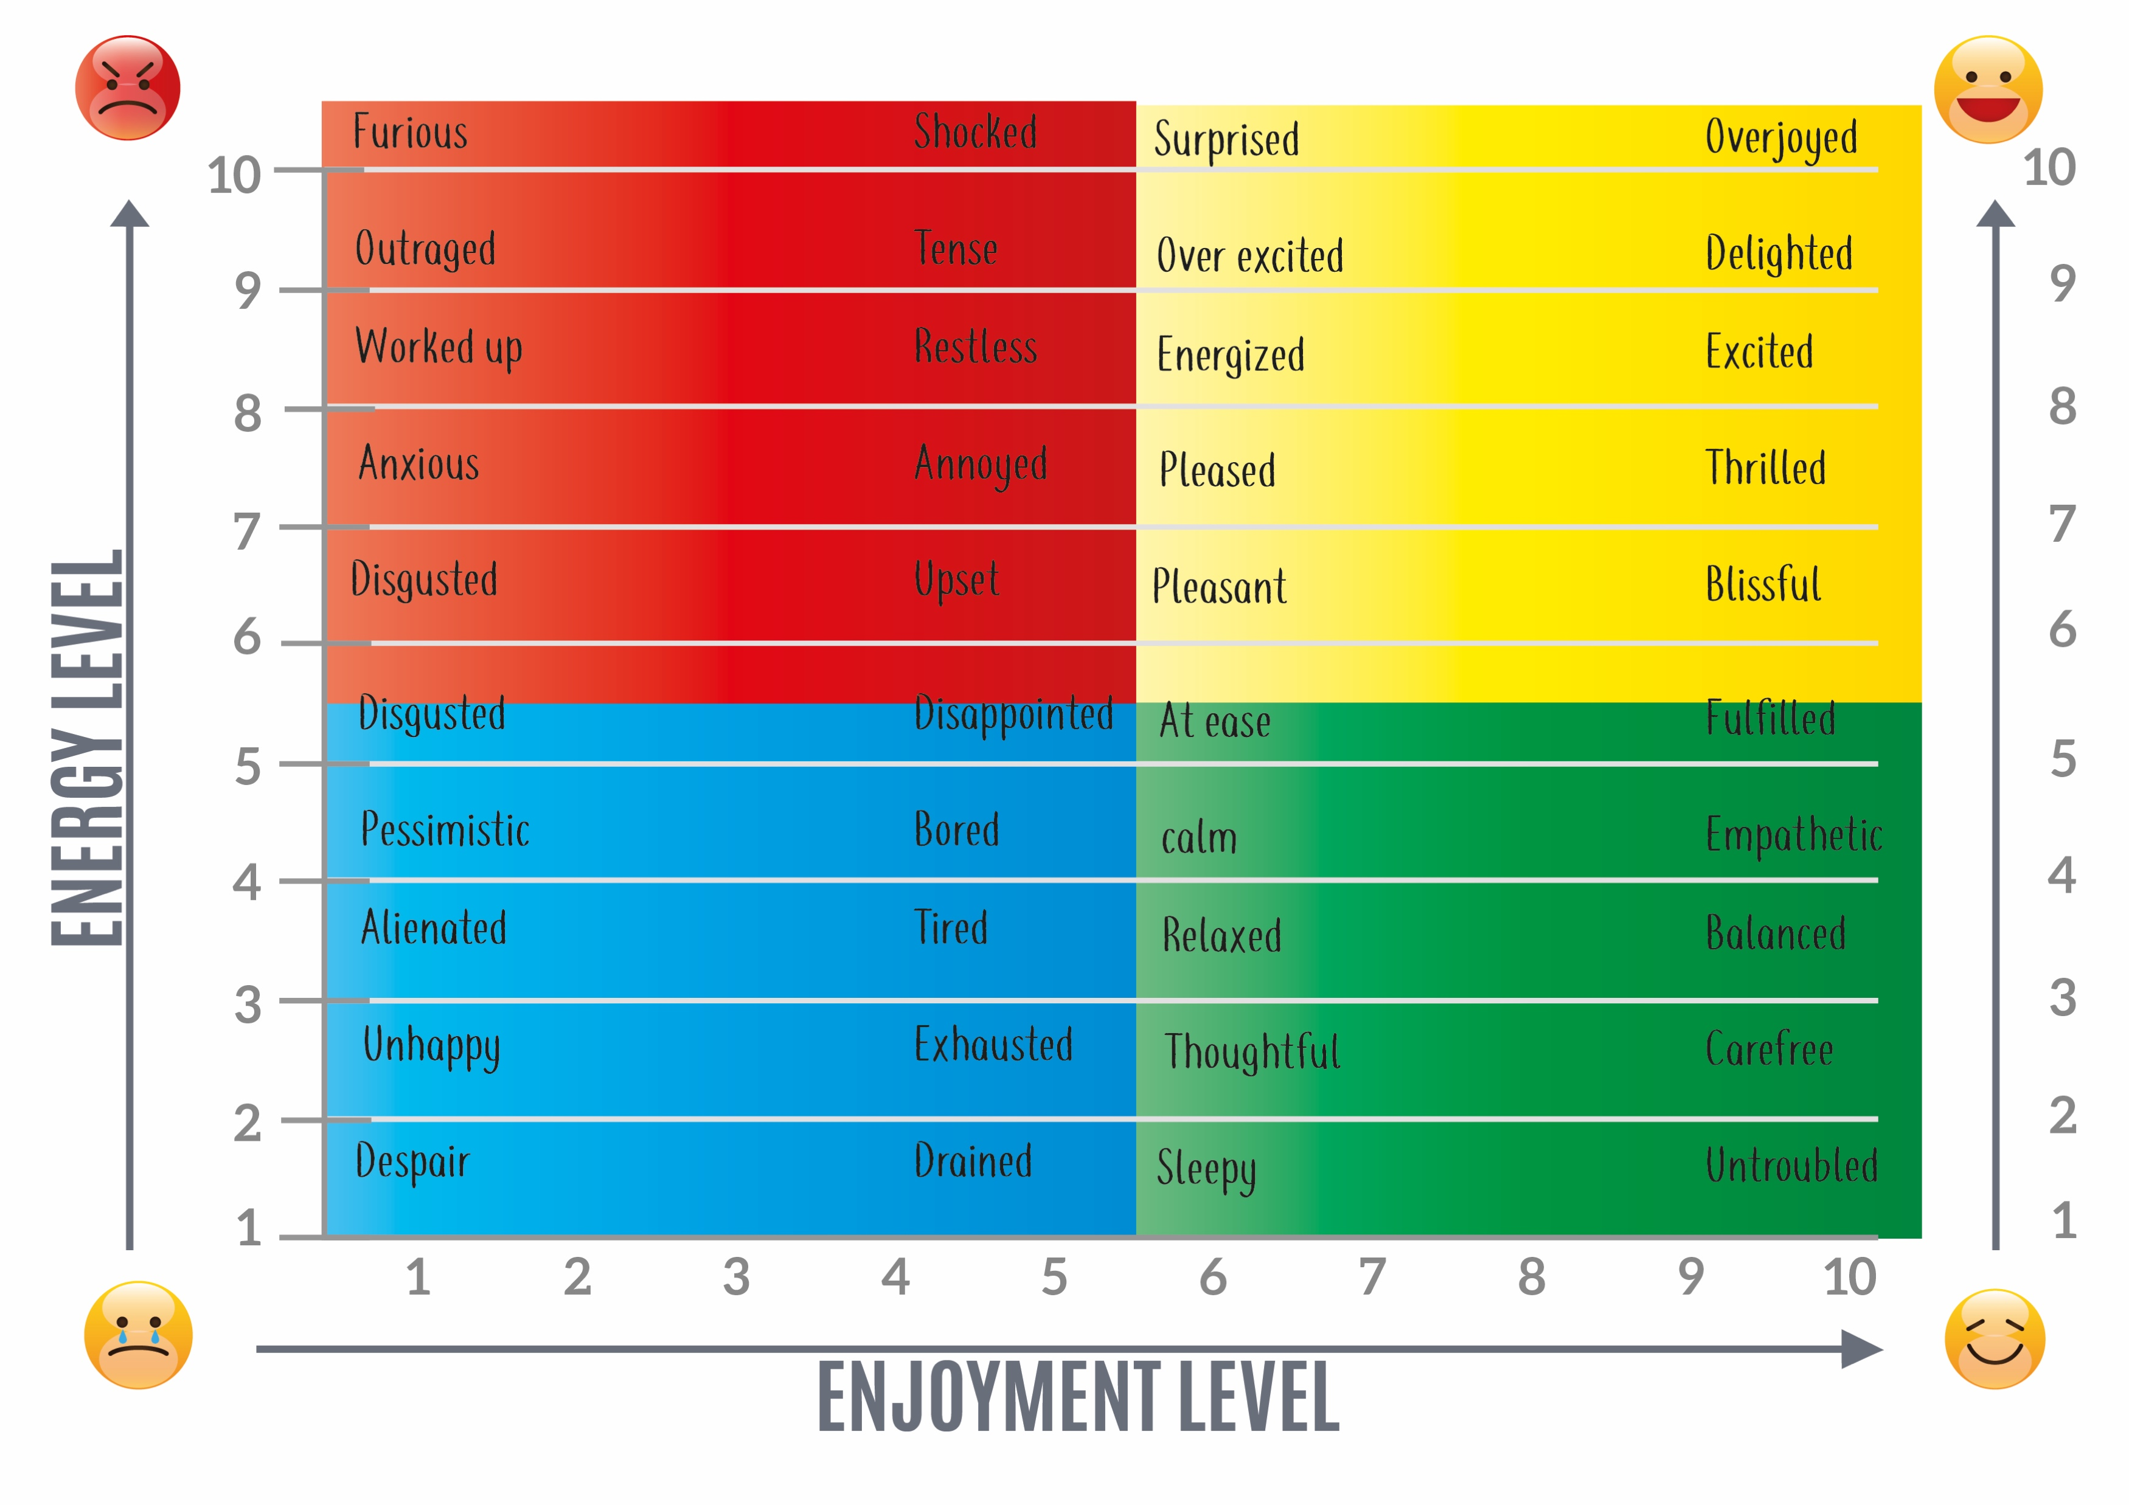
How many did you
manage to get from this
list?

Slide 11
The Yale Center for Emotional Intelligence developed an approach called the:
Regulate
Recognising emotions in oneself and others.
Understanding the causes and consequences of emotions.
Labelling emotions with a detailed vocabulary.
E
R
R
U
L
Expressing emotions in an appropriate and constructive way.
Regulating emotions with helpful strategies.

Slide 12
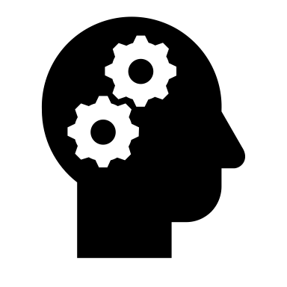
RULER WORKSHEET
What happened? Describe an event where you experienced an intense emotion.
Recognise | How did I feel? | Describe the sensations you had during this event. What was happening to your body? What thoughts were rushing through your head?
Understand | What caused this feeling? | Think about what actions, words, or events led up to you and the other person having these feelings.
Label | Give the feeling a name? | Use your mood metre and label what emotion you felt.
Express | How did I express this feeling? | What words or actions did you use to express this emotion?
Regulate | What could I have done to handle the situation better? | What techniques could I use in future to avoid these intense emotions taking over? For example: SBLR: Stop, Breathe, Listen, Respond Mindfulness (What can I hear? What do I feel?) Belly breathing

Slide 13
Exercises to regulate our emotions

Slide 14
Mindfulness
‘Mindfulness is awareness that arises through paying attention, on purpose, in the present moment, non-judgementally.’
- Jon Kabat-Zinn
Activities to practice mindfulness are:
What am I feeling?
What can I hear?
Notes:
Mindfullness is a mental training practice that involves focusing your mind on your experiences
(like your own emotions, thoughts, and sensations) in the present moment.
IF we can acknowledge our emotions and how they manifest inour bodies we can better identify them when in the moment and know how to manage them.

Slide 15
SBLR

Stop

Breathe

Listen
Respond
Notes:
Stop… Take your self away from the situation for a moment.
Breathe…. Breathing helps the body relax so that you can calm yourself.
Listen… Practice your Mindfulness. Listen to what you are feeling, acknowledge it. Why are you feeling this way?
Respond… What can you do so you can respond to the situation in a way that is not destructive or hurtful to yourself and the other person.

